Slide 1
Act on Designer Bacteria
Saurabh Srivastava
and the Act team
http://pathway.berkeley.edu/
http://pathway.berkeley.edu/visuals/reach/

Slide 2
User exploration
Act Discoverer
Chemical target of interest
Act Synthesizer
Predicted pathways
(all possible)
Predicted plausible enzymes
Data Sources
Enzyme
Organism
Sequences
Chemicals
Chem. Prop.
Pubmed
Genbank
Biochemical pattern learning
Data integration

Slide 3
Teaser trailer
http://pathway.berkeley.edu/visuals/act-discoverer-synthesizer-trailer.mov

Slide 4
I would have been a biochemist; had it been taught as a data mining algorithm

Slide 5
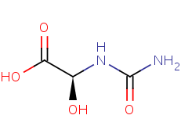
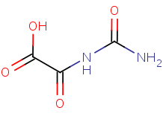
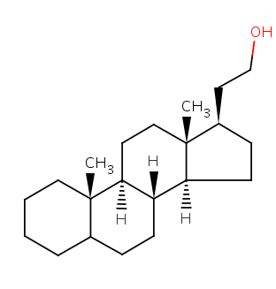

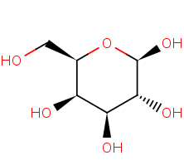
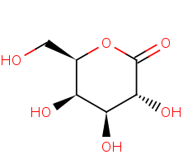
*
*
*
*
Reaction Operator
(algorithmically mined)

Slide 6
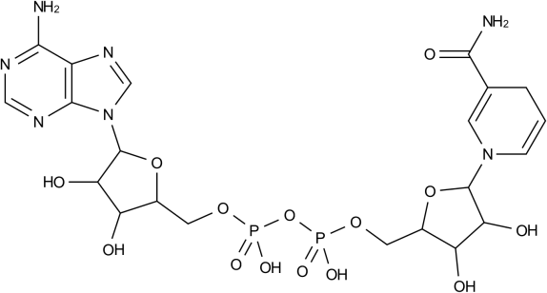
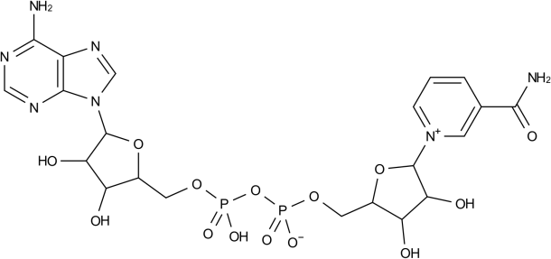
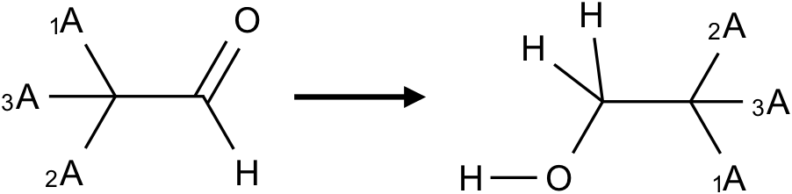
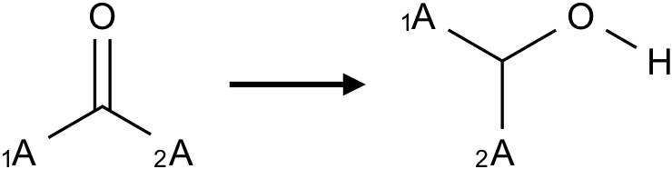
{Saccharomyces cerevisiae} acetaldehyde + NADH + H+ -> ethanol + NAD+
10s-100s of thousand observations
+
+
~2133 Electronic Reaction
Operators ( encode VSEPR)
Greater Confidence
Greater abstraction
~1042 Core Reaction Operators (encode Mass Conservation)

Slide 7
When predicting function, EC stands for enzyme crap

Slide 8
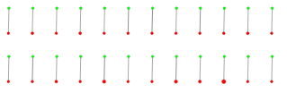
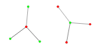
EC Class (e.g., 1.1.1.1)
Act Operator Class
Sometimes an EC class is too aggregate and clubs together many chemistries
A reaction that is in the EC class goes to the Act operator
Sometimes the same chemistry is scattered across many different EC classes

Slide 9
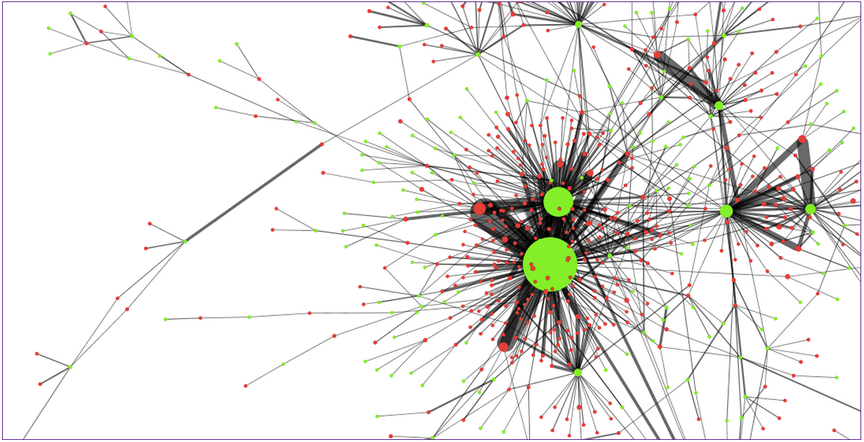
Act Reaction Operator
EC Class, e.g., 1.1.1.1

Slide 10
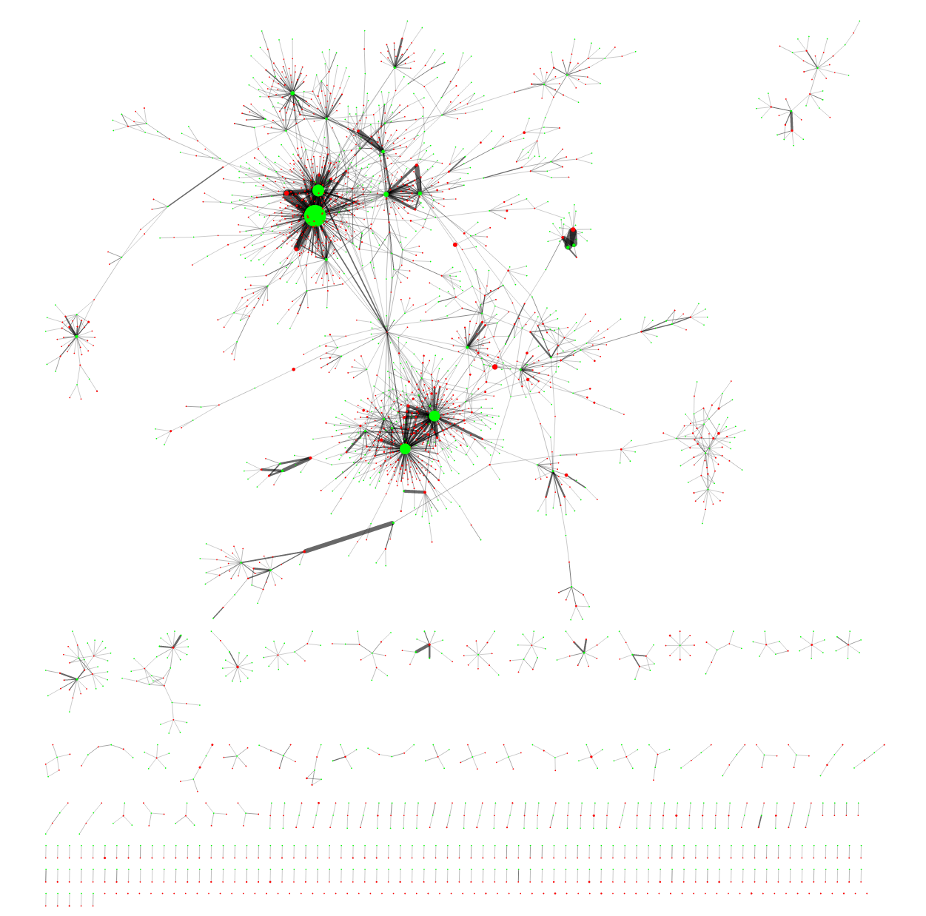
To be fair, the situation is
bad in some classes
not as grim elsewhere
EC only works…
As a cofactor hierarchy
As a proxy for function
For true enzyme function Act RO’s are better

Slide 11
You can read papers without knowing the language

Slide 12
Ideal:
Domain knowledge
Input text
NLP
English Understanding
Output information content
Mostly:
Act’s approach:
Domain knowledge
Domain knowledge
Input text
Input text
NLP
NLP
English Understanding
Output information content
Output information content
English Understanding

Slide 13
Prob = 0.52
Prob = 0.05
Prob = 0.12
synthase
Prob = 0.01
Prob = 0.30

Slide 14
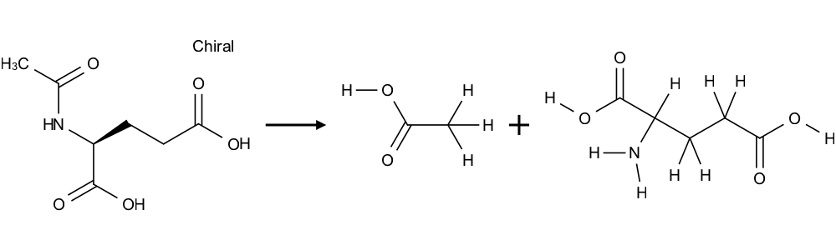
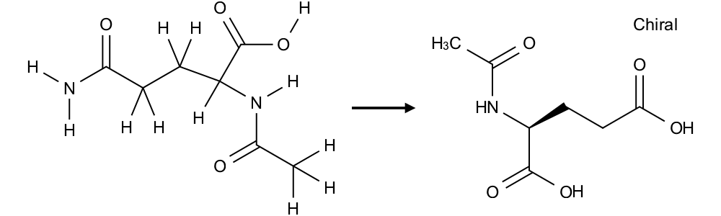
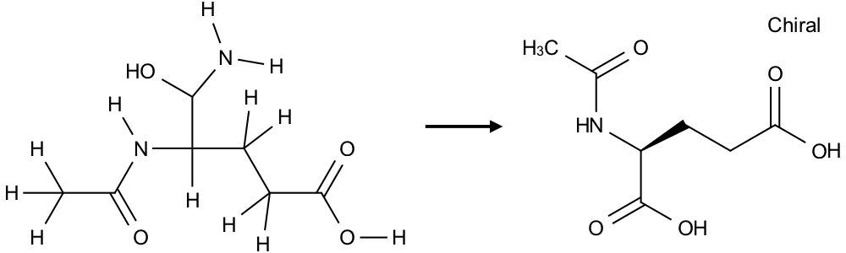
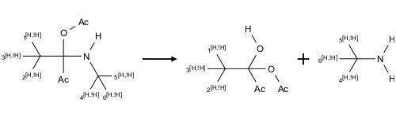
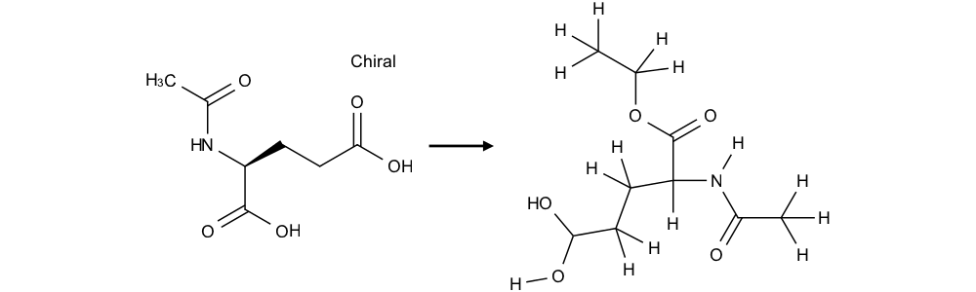
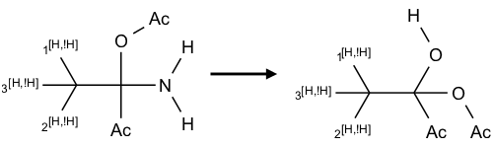
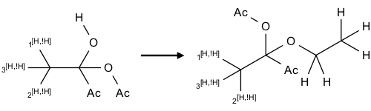
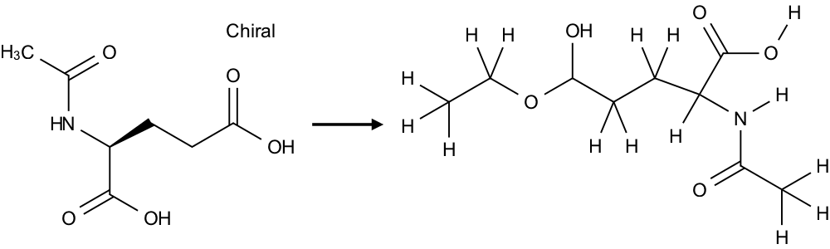
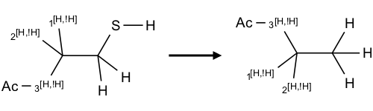
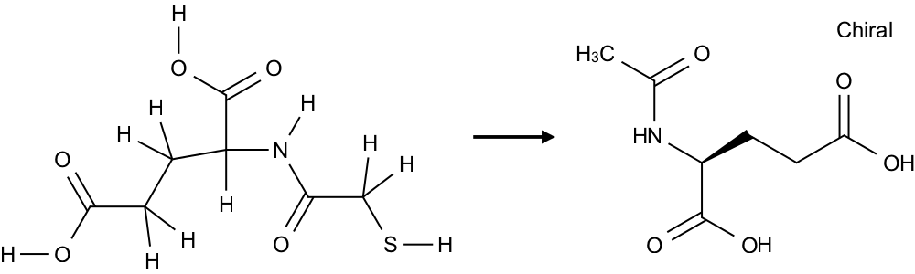
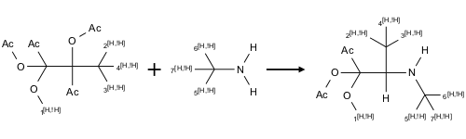
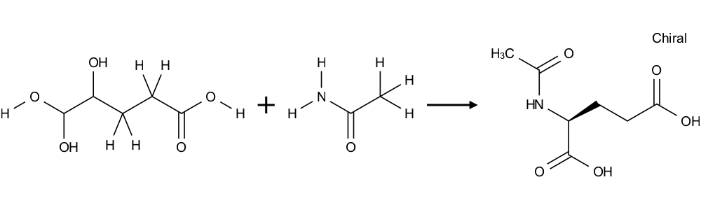
Prob = 0.52
Prob = 0.05
Prob = 0.12
Prob = 0.01
N-acetylglutamate synthase
Prob = 0.30
Accession: AB005263
Description: Buchnera aphidicola argA mRNA for N-acetylglutamate synthase, partial cds.

Slide 15
Why go after one small molecule when you can look for all?

Slide 16
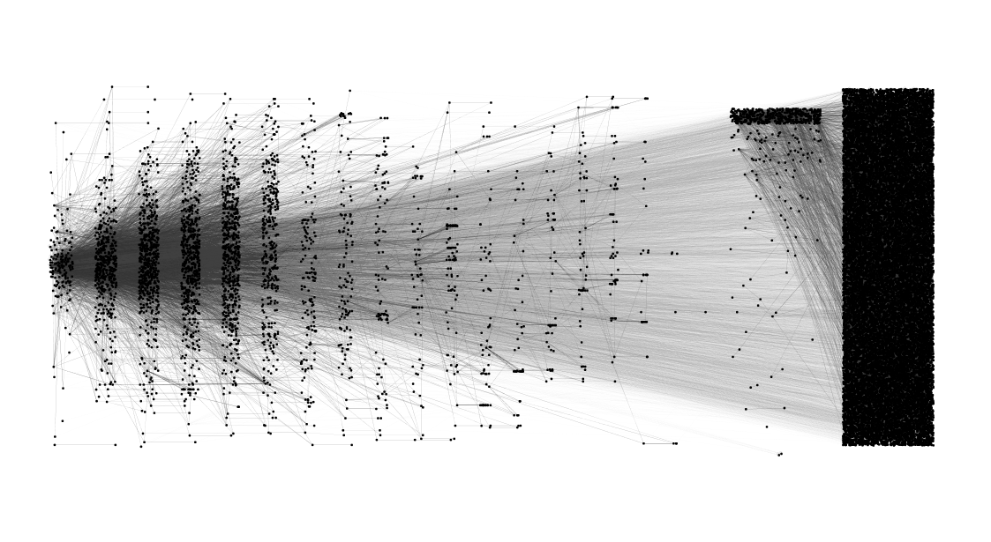
Reachable
(using known enzymes across all organisms)
Unreachable
Primary metabolism (approximately)

Slide 17
Maybe we should take more leaps-of-faith, chemically speaking

Slide 18
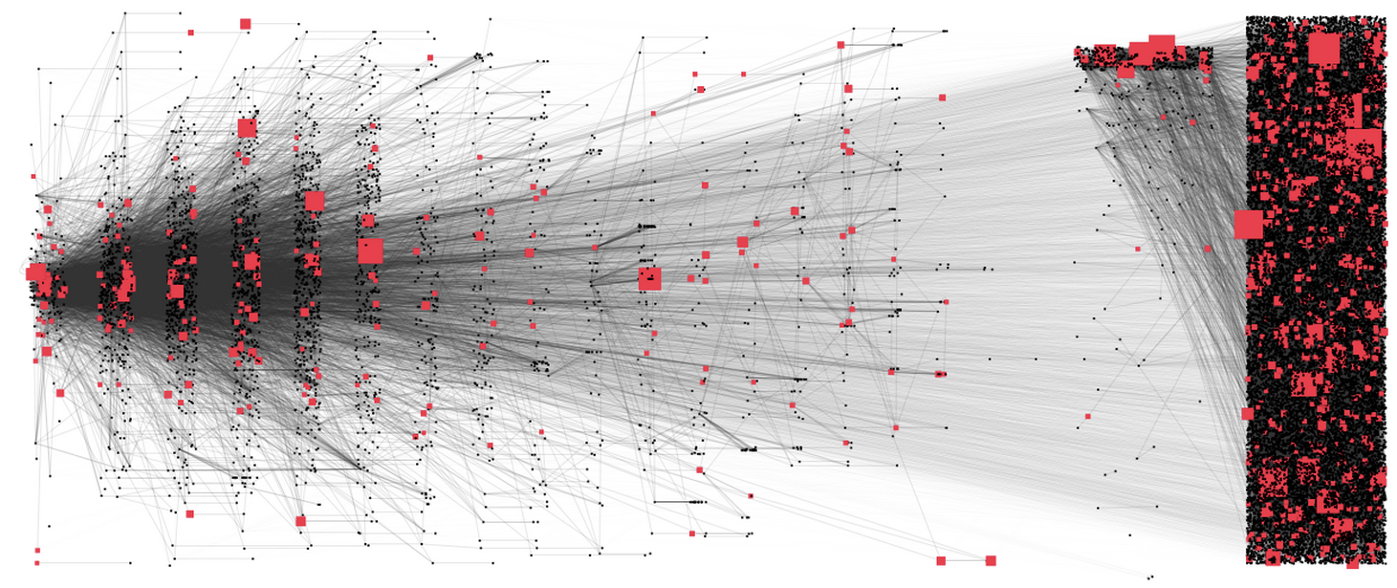
Chemicals sized by Sigma Aldrich prices

Slide 19
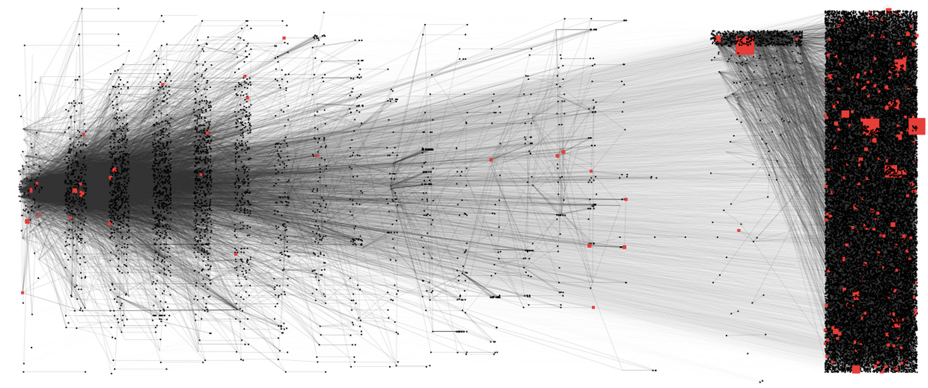
Chemicals that are therapeutic drugs; and sized by price

Slide 20
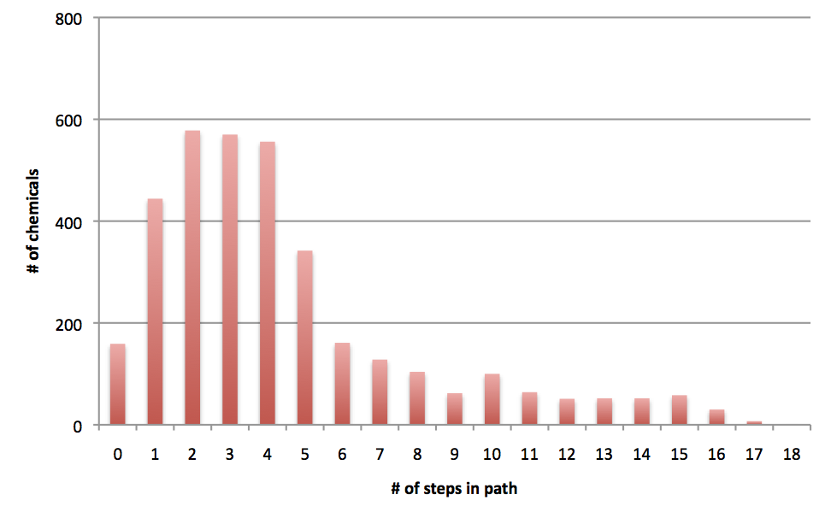
The number of reachable chemicals in the layered diagrams earlier (L->R)

Slide 21
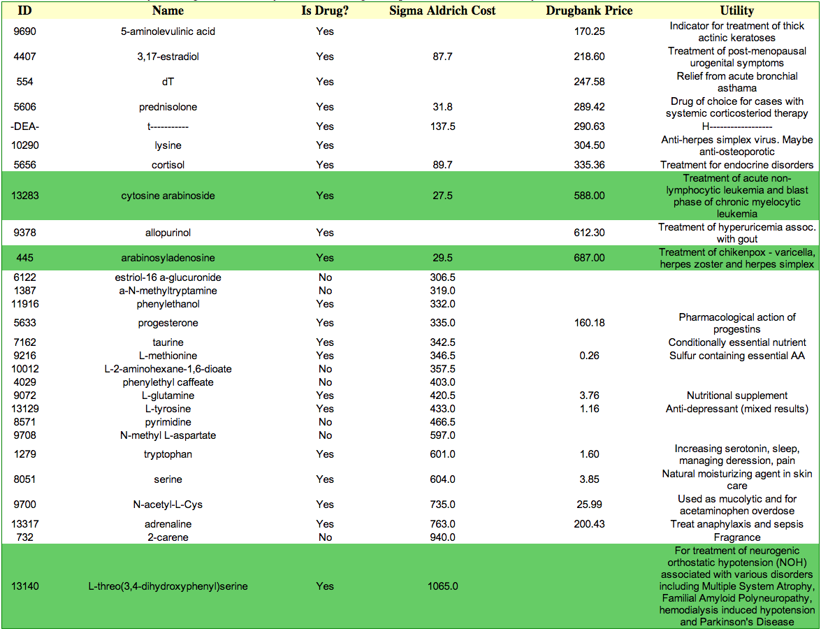
A sampling of the reachables

Slide 22
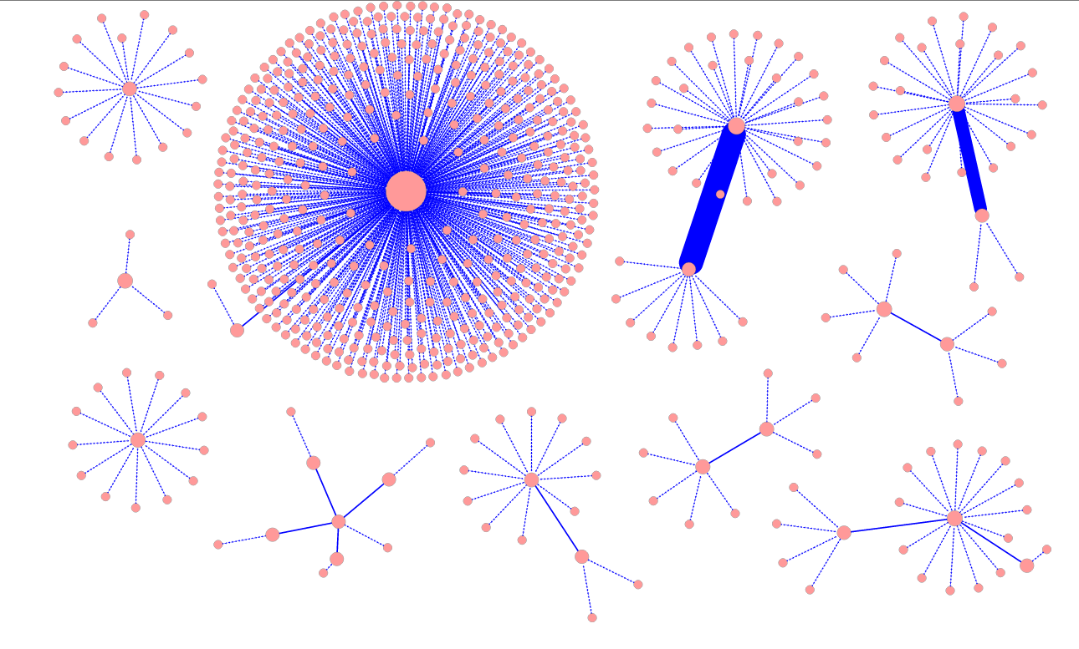
Analysis of the unreachable chemicals reveals that there are clusters of them.
Each big central node here is a cluster of chemicals; and surrounding them are chemicals that if reached will make the central cluster of chemicals all reachable. E.g., the biggest cluster of 544 chemicals (big dot in center) can be enabled if any of its surrounding chemicals are reached.

Slide 23
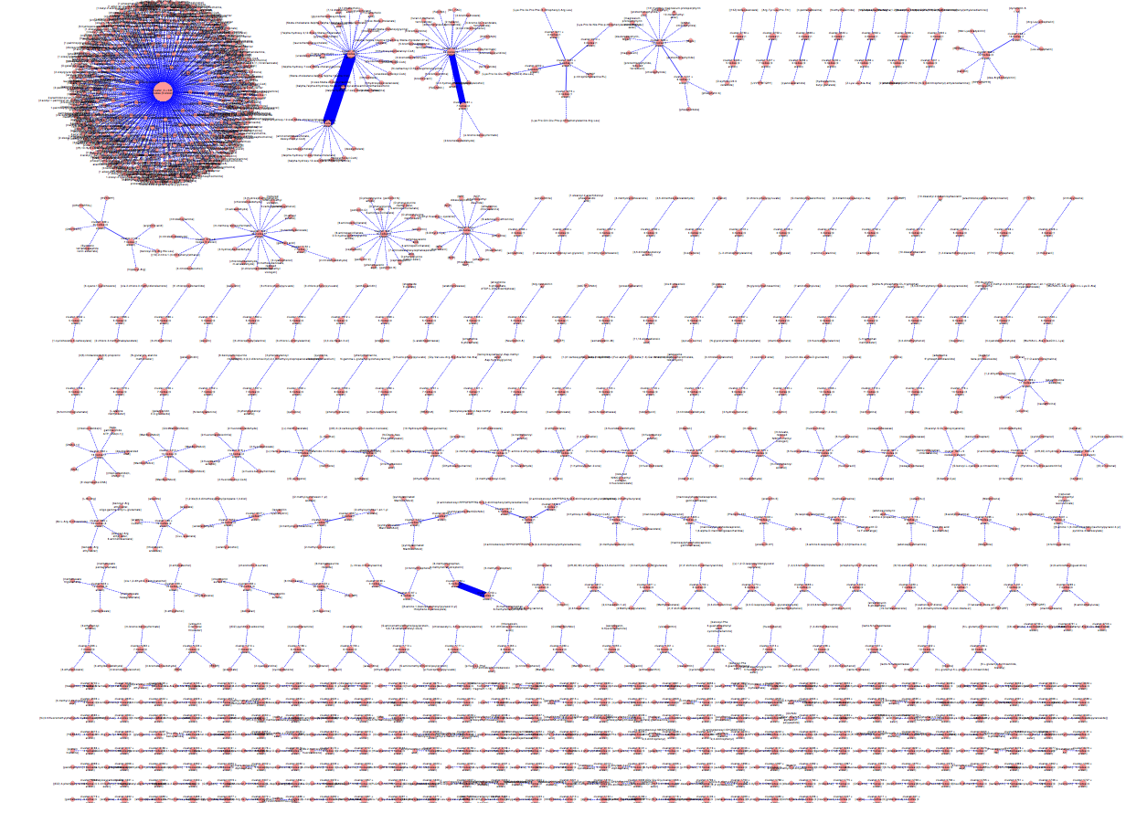
The previous was just a sampling (clusters with sizes>20 chemicals each). This is what the entire unreachable space looks like. (Click for high-res SVG)

Slide 24
Maybe the general public should not
(take as many leaps)

Slide 25
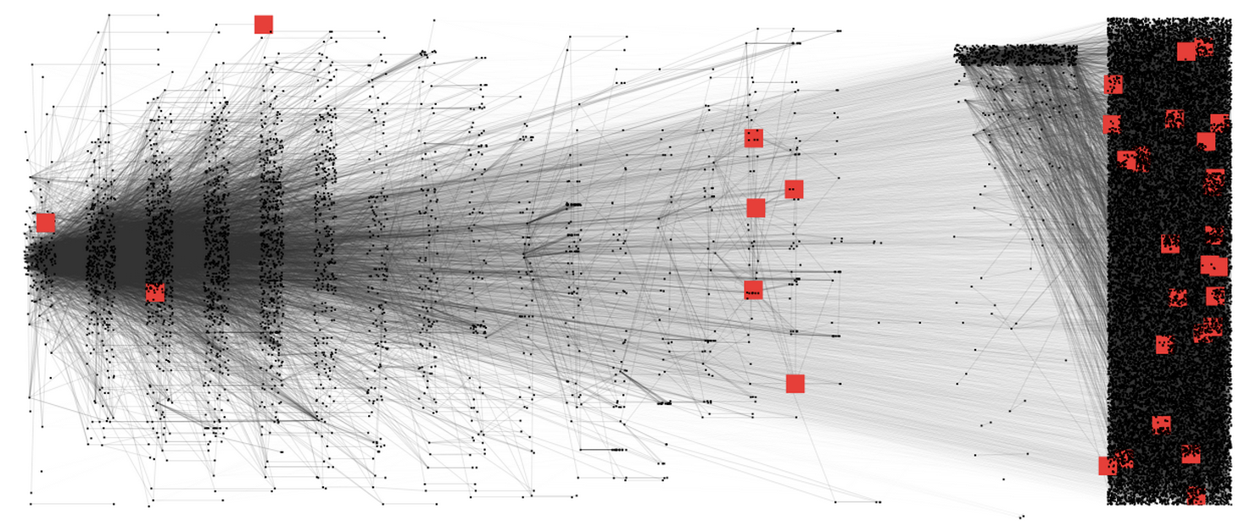
Chemicals that are on the DEA list

Slide 26
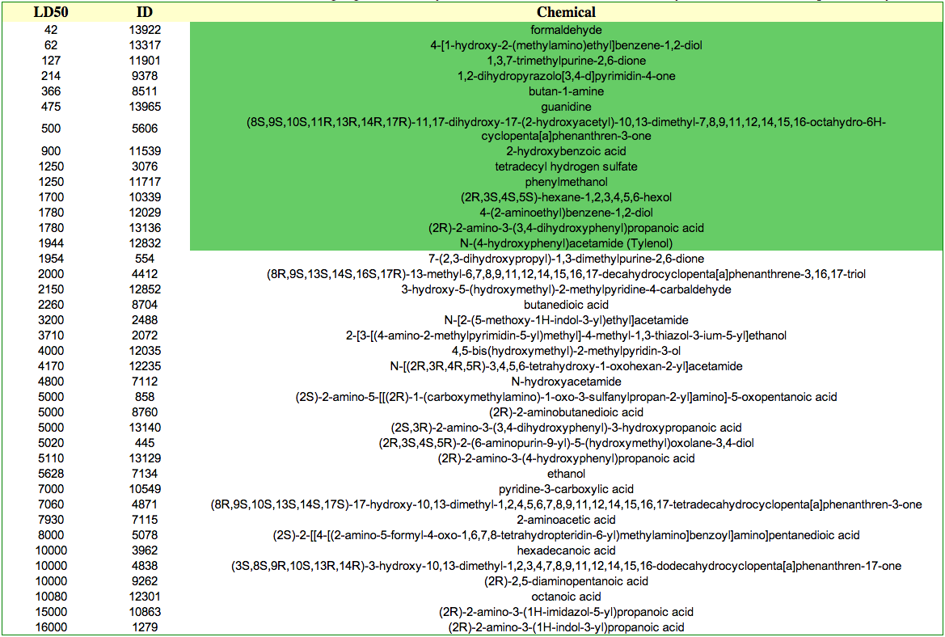
Mammalian toxicity (Median Lethal Dose values)
Highlighted more toxic than Tylenol (of which 12g is lethal for humans)

Slide 27
Education-based mitigation strategy

Slide 28
Encrypted monitoring-based mitigation strategy

Slide 29
What is an unnatural chemical?

Slide 30
A matter of opinion?
Is biosynthesis in E. coli of Artemisinin unnatural?
Is biosynthesis in E. coli of 1,4-BDO unnatural?
Is biosynthesis in E. coli of Tylenol unnatural?

Slide 31
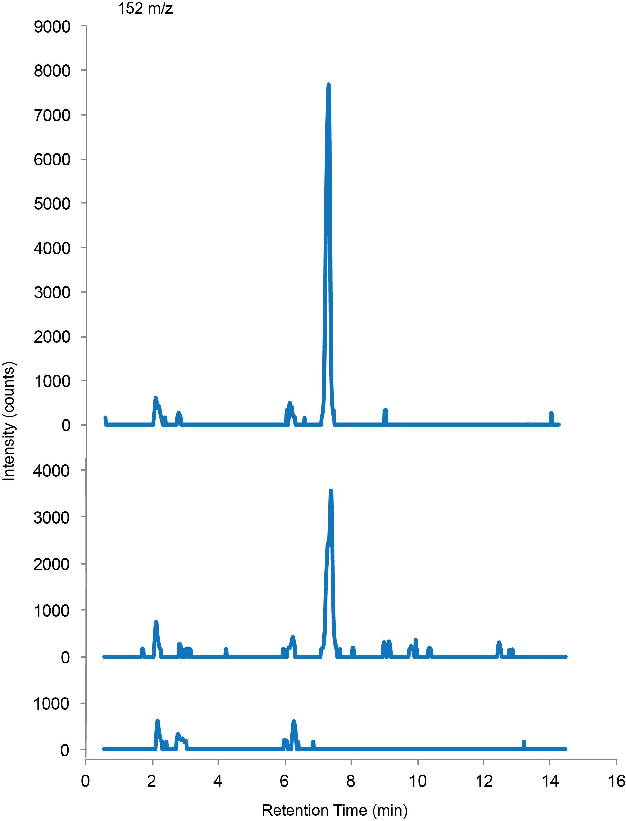
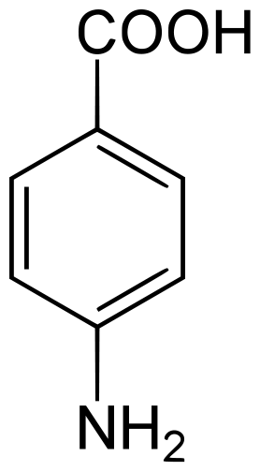
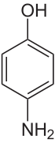
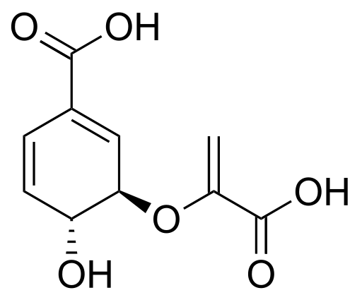
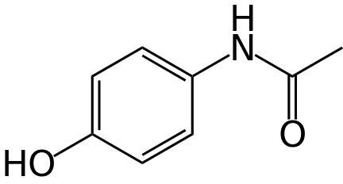
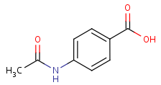
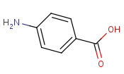
Is biosynthesis in E. coli of Tylenol unnatural? (Proof-of-concept for Act’s predictions in the wetlab)
4ABH:
Gene from a mushroom
Also works on 4-aminosalicylate, 4-amino-2-chlorobenzoate, and others…
4ABH
Standard control
pabABC
Our pabABC+4abh.nhoa strain
Chorismate pathway
PABA
4-aminophenol
acetaminophen
Negative control strain
nhoA
nhoA:
Native E. coli gene
Best substrate: p-aminobenzoic acid
4-aminophenol 4th best, but almost same Km

Slide 32
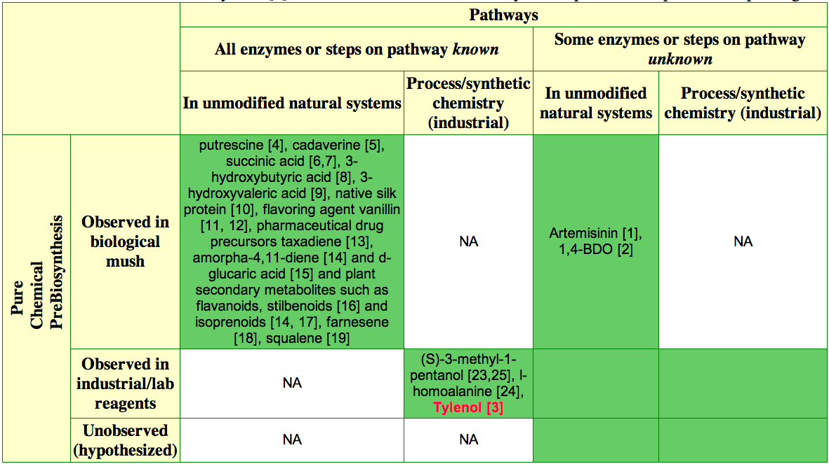
We will go after a target in this category next
Act predicted pathway; and engineered strain works as predicted

Slide 33
Biology is buggy, so should your algorithms for predicting it, but let the bugs be precise

Slide 34
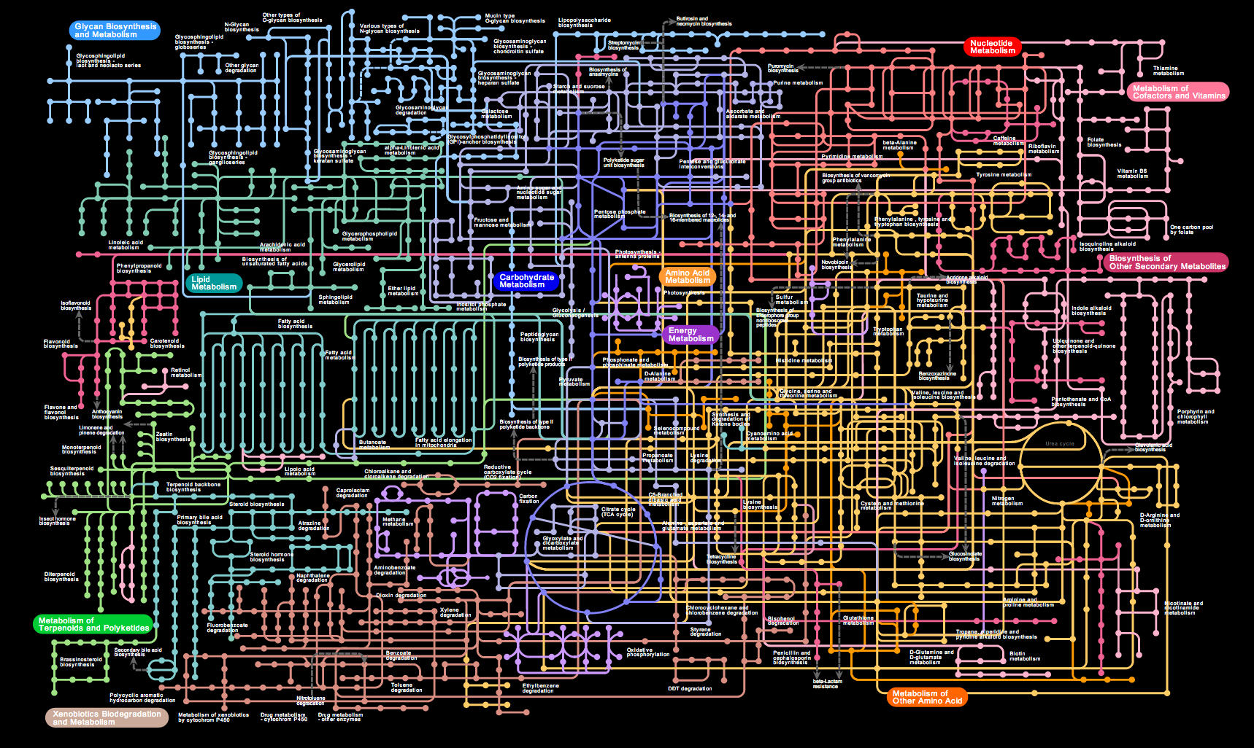
Paths through this are boring:
Each rxn hand-written: Unlikely to find unexpected chemicals.
No predicted reactions
Algorithmically boring because without hyperedges you don’t have NP-completeness

Slide 35
Fun: Fast and loose with data… … but in a very precise way
Enz_{X}
a + b → c
(lets say known)
Enz_{X}
a + b ← c
Reverse
Machine learning algorithm for evaluation the relation ((a,b,c,dir,Enz_{X}), (a’,b’,c’,dir,Enz_{Y}))
Enz_{X}
a’ + b → c
Unnatural substrate
Enz_{Y}
a’’ + b’’ → c’’
Alternative sequence

Slide 36
Intelligent, selective amnesia gives you predictive powers

Slide 37
Forget first, then remember
Enz_{new}
Enz_{X}
a’ + b’ → c’
a + b → c
(predicted enzyme)
(precisely observed enzymatic reaction)
Forget
Kinetics
Stereochemistry
Reversibility
Substrate specificity
Atom electronics
Electron sharing (bonds)
Remember

Slide 38
You are only utilizing 13.76% of your potential without the Act crystal ball (reaction operators)

Slide 39
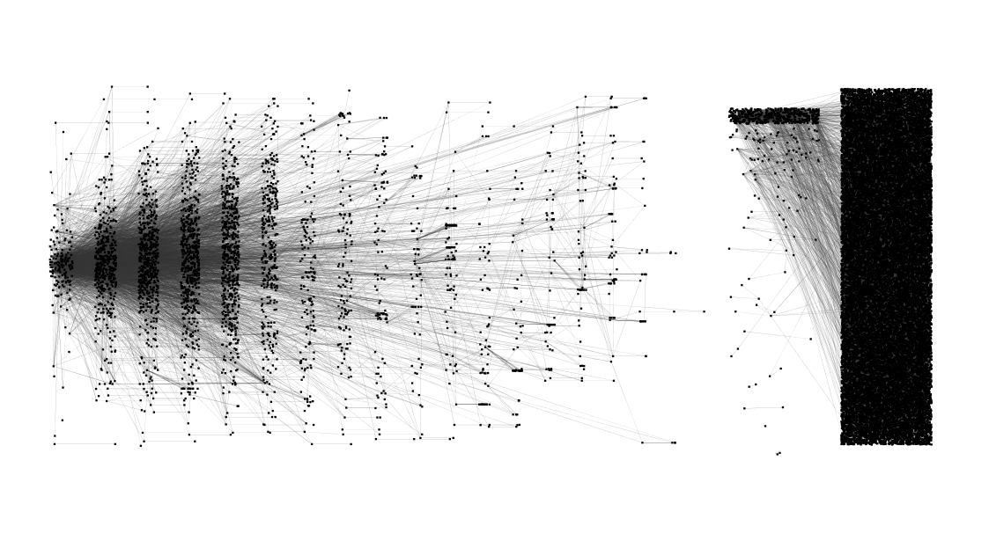
13.76%
The natural divide
86.24%

Slide 40
If you did it naively, it will take 180 compute hours for single substrate operators; and 180^2 for double, and …
So: Be more goal-oriented.

Slide 41
Elevator traversals don’t need to be precise, biosynthesis paths do

Slide 42
Metrics:
Cofactor usage, carbon loss
Expression in E. coli
Pairwise enzymes on path
Complexity: Exponential # of paths, so cannot enumerate
But AI planning/Verification/Synthesis solve these routinely
Other: steady-state flux, thermo

Slide 43
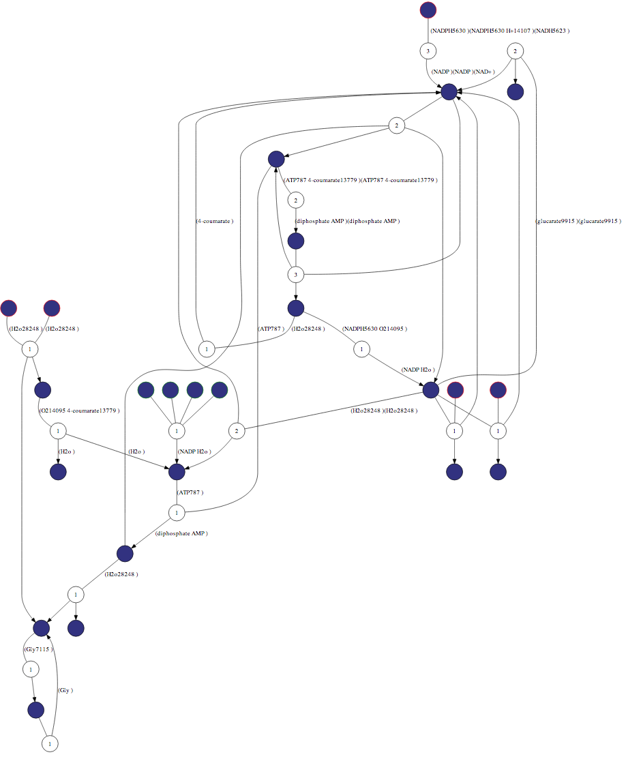
Ranked network of plausible engineering options
Eventually, the nodes for chemicals will be colored from red to blue based on the viability of the paths passing through them

Slide 44
Demo time; but maybe a few last words…

Slide 45
The Act Commandments
I: Don’t touch the data, use the algorithm.
II: Predict future biological data. E.g., mushroom gene in Tylenol would have been predicted to exist by Act (in the hypothetic case it wasn’t tested)
III: If you are a low-throughput lab, that’s ok. Just supplement it with high throughput Act-like learning algorithms.
IV: If you are a high-throughput lab, that’s ok too. Submit all your data to Act and see what other targets are enabled.
V: Standardization is good, but not critical. Data is critical. Noise is ok. Write algorithms to fix both.
VI: Be data driven. I.e., don’t touch the pipette unless an algorithm tell you to.

Slide 46
The Future
A: Explore how connected the space gets with lit-mining, SAR, reaction operators
B: Process chemistry reaction operators for hybrid biosynthesis + synthetic chemistry pathway prediction
C: Data analysis for identification of interesting (drug, commercial) chemical spaces that are close-to-reachable. Leads to directed search for predicted enzymes. Find chemical space that can be explored using high-throughput assays
D: Hypothesis generation: If your strain generates a chemical, find explanation
E: Small tweaks: Identify best branch-away metabolite from major metabolic pathways; Given high flux metabolite (e.g., acetyl-CoA) find pathway through it; instead of one target, best pathway for a chemical bouquet

Slide 47
See more…

Slide 48
Chemicals by their difficulty of biosynthesis
L₀: Pathway exists in E. coli
L₁: Pathway exists in other organism
L₂: Pathway requires mix-n-match across different organisms, but enzymes exist natural
L₃: Natural enzymes exist but new substrate unnatural (i.e., SAR predicts enzyme should work)
L₄: Transformation natural but substrate unnatural (i.e., no SAR applies)
L₅: Unnatural catalytic transformation
Enzyme sequence available: L₀-L₃
Low confidence sequence prediction possible: L₄
De-novo sequence construction required: L₅

